Slide 1
*Prelab提交方式更改
根据3月20日的群投票，现决定prelab改为BB提交。
Lab2-prelab提交截止时间为3月25日23:59
之后所有prelab提交截止时间为做实验前的周日23:59

Slide 2
Lab1主要问题
绘图未标注label，title，legend等细节信息
函数绘图必须标明坐标轴label，对于一个图像上的多个信号需要用不同linestyle表示，并用legend区分，不同图像需要加上title标注
数值法与符号法混淆
建议使用 ; 取消输出

Slide 3
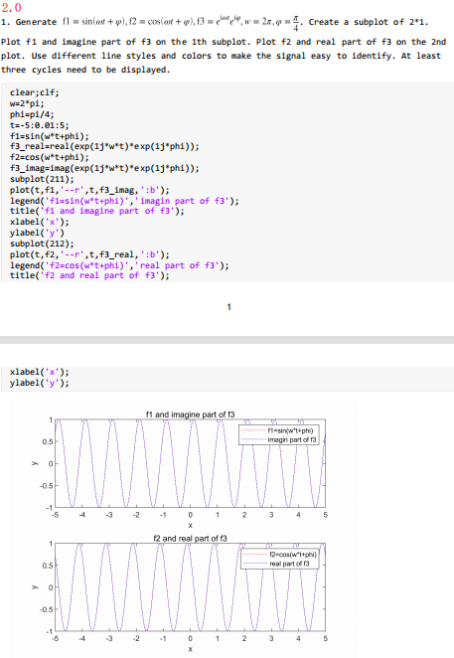
第1题
函数f3虚实部计算方式不当
主要考察对于MATLAB内置函数real（）与imag（）的使用，不建议使用手算直接得到结果
角频率计算错误
对于信号的角频率计算公式 w = 2*pi*f 掌握不到位，在构建信号函数上出错

Slide 4
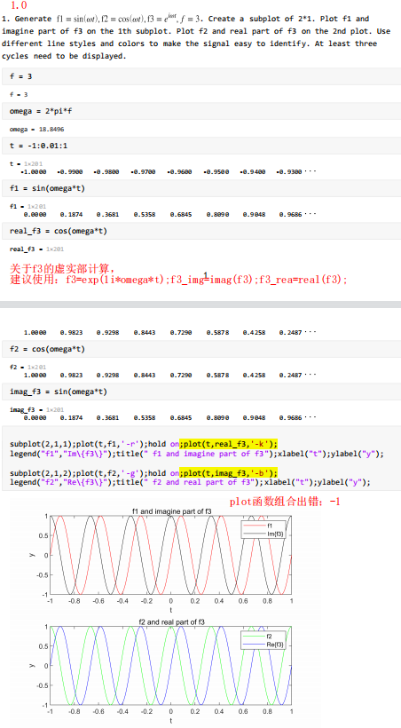

Slide 5
第2题
数值法求导，没有 /0.01
x = -1:0.01:2;
y = exp(x + power(x,2));
y_2nd_diff = diff(diff(y));
plot(x(2:end-1),y_2nd_diff,"-r");
纵轴设置不当，axis ( [0 3 -30 30]); 导致图像显示不全

Slide 6
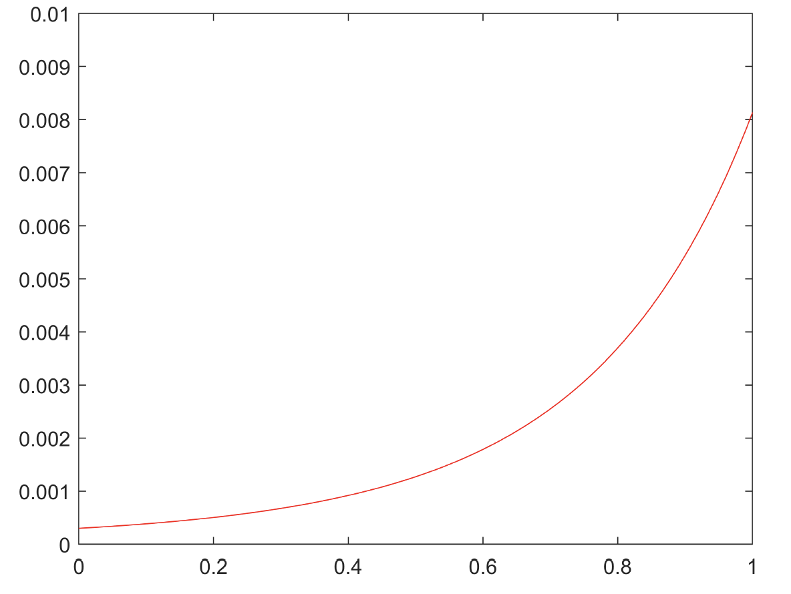
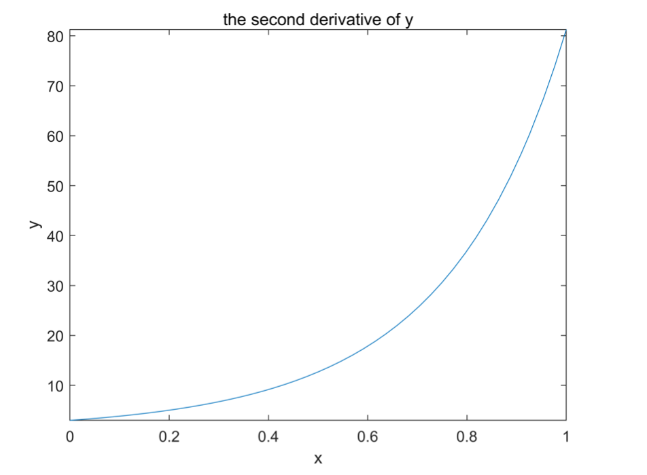
缺少label，title，legend
数值法求导，未 /0.01
错误：
x = -1:0.01:2;
y = exp(x + power(x,2));
y_2nd_diff = diff(diff(y));
plot(x(2:end-1),y_2nd_diff,"-r");
正确解法：
数值法：
clear;clf;
dt = 0.01;
x = 0:0.01:1;
y = exp(x + x.*x);
y1 = diff(y)/dt;
y_2nd_diff = diff(y1)/dt;
plot(x(1:99),y_2nd_diff,"-r");
title('the second derivative of y')
xlabel('x')
ylabel('y')
符号法：
clear;clf;
syms x
y1=exp(x+x*x);
y2=diff(y1,2)
fplot(y2,[0,1]);
title('the second derivative of y')
xlabel('x')
ylabel('y')

Slide 7
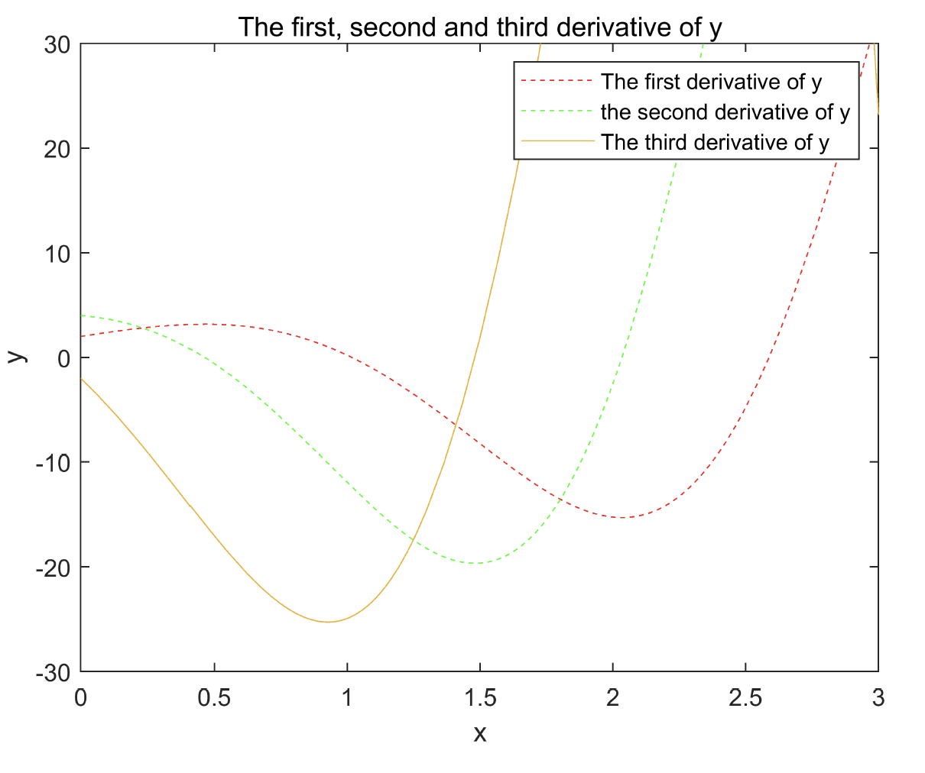
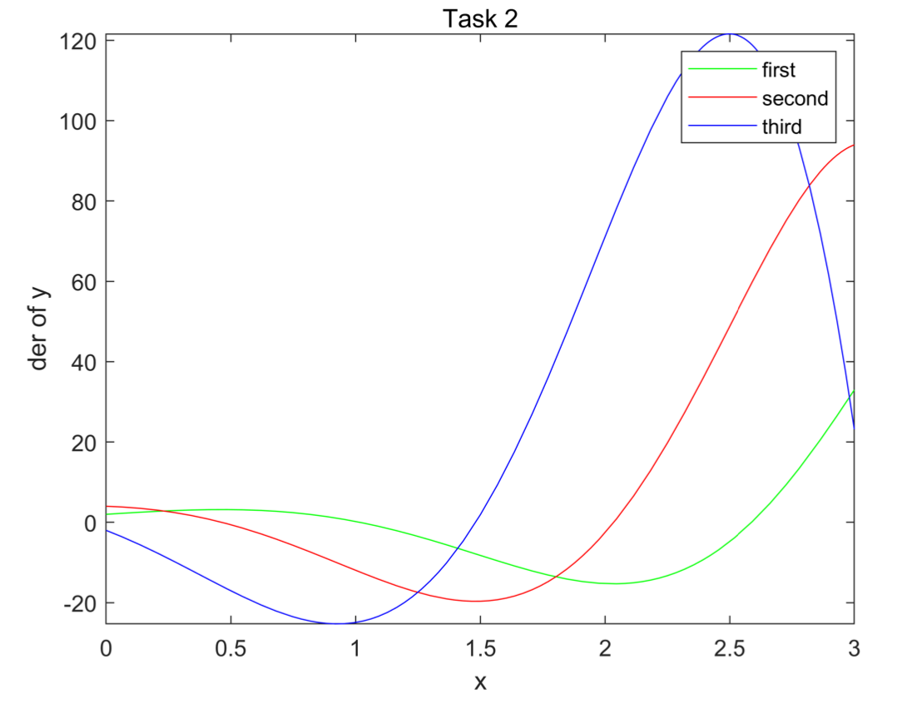
纵轴设置不当，axis ( [0 3 -30 30]); 导致图像显示不全
clear;clf;
syms x;
y = exp(x)*sin(2*x);
y1 = diff(y,x);
y2 = diff(y1,x);
y3 = diff(y2,x);
fplot(x,y1,"--r");
hold on;
fplot(x,y2,"--g");
axis ( [0 3 -30 30]);
fplot(y3);
xlabel("x");
ylabel("y");
legend("The first derivative of y","the second derivative of y","The third derivative of y");
title("The first, second and third derivative of y");
hold off;
正确解法：
clear; clf;
syms x
y = exp(x)*sin(2*x);
y1 = diff(y,x);
y2 = diff(y1,x);
y3 = diff(y2,x);
fplot(y1,'g',[0 3]); hold on;
fplot(y2,'r',[0 3]); hold on;
fplot(y3,'b',[0 3]); hold off;
title('Task 2')
xlabel('x')
ylabel('der of y’)
legend('first','second','third')

Slide 8
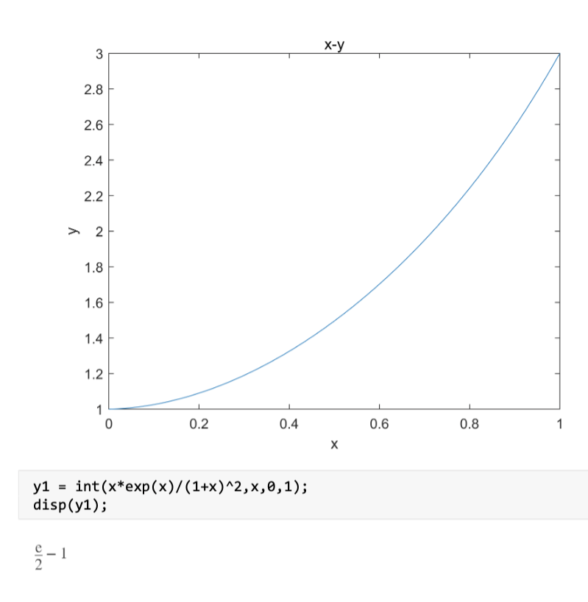
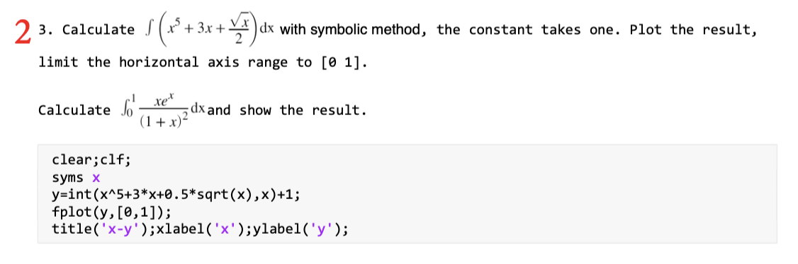
第3题
不定积分遗漏常数项
限制坐标范围时，混淆纵坐标和横坐标

Slide 9
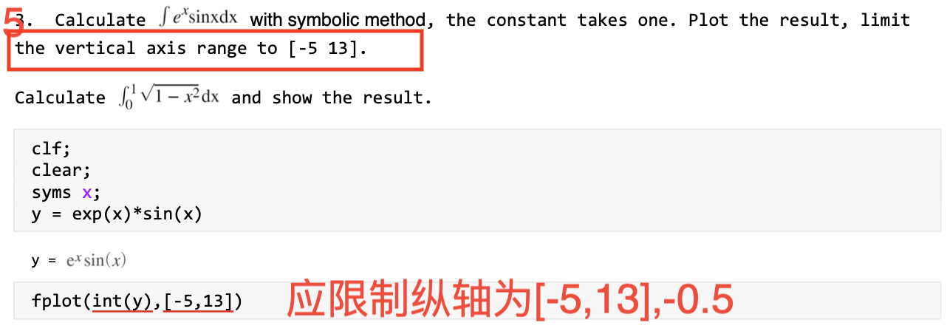
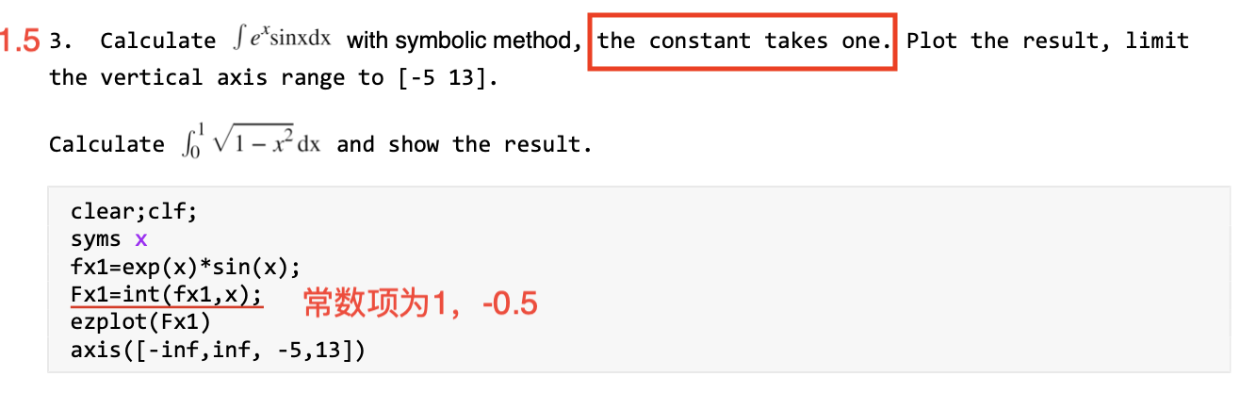

Slide 10
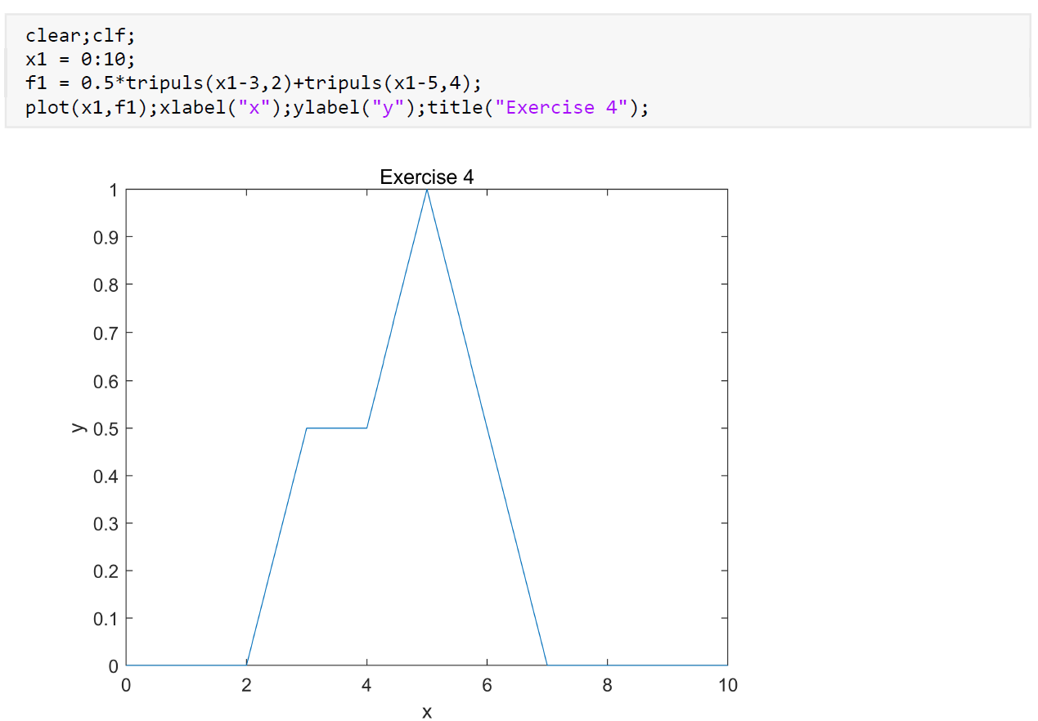
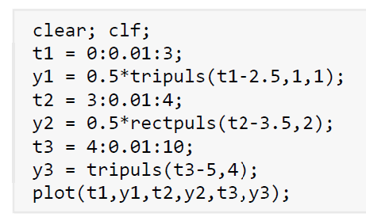
第4题
读题不仔细，结果不符合题目要求
对称轴选择错误
采样率选择错误
不使用数值法完成
没有使用信号基本操作，拼凑结果（周三题目）
使用分段函数操作

Slide 11
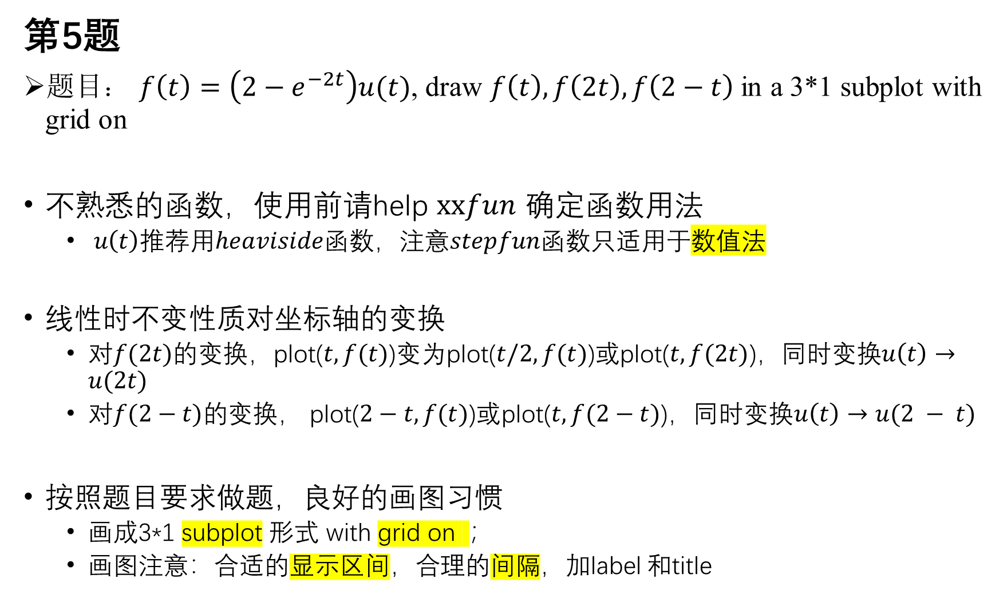
第5题
题目： $f\left(t\right)=\left(2−e^{−2t}\right)u(t)$, draw $f\left(t\right), f\left(2t\right), f\left(2−t\right)$ in a 3*1 subplot with grid on
不熟悉的函数，使用前请help $xxfun$ 确定函数用法
$u\left(t\right)$推荐用$heaviside$函数，注意$stepfun$函数只适用于数值法
线性时不变性质对坐标轴的变换
对$f(2t)$的变换，plot($t,f(t)$)变为plot($t/2,f(t)$)或plot($t,f(2t)$)，同时变换$u\left(t\right)→u(2t)$
对$f(2−t)的$变换， plot($2−t,f(t)$)或plot($t,f(2−t)$)，同时变换$u\left(t\right)→u(2 − t)$
按照题目要求做题，良好的画图习惯
画成3*1 subplot 形式 with grid on ；
画图注意：合适的显示区间，合理的间隔，加label 和title

Slide 12
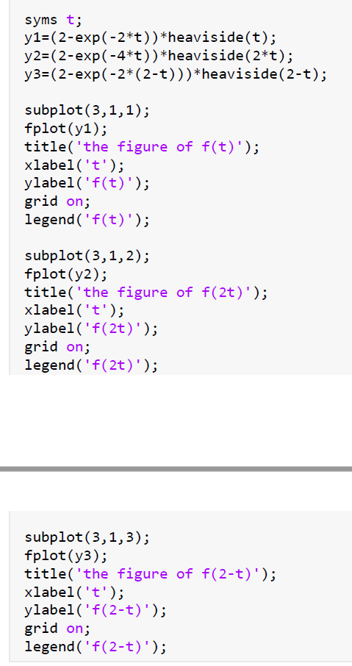
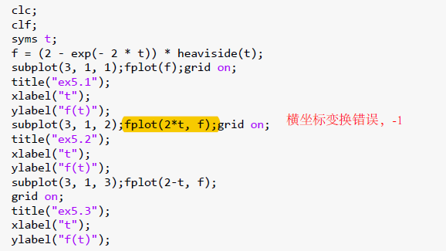

Slide 13
Lab 2 System Analysis in Time Domain

Slide 14
Objective
Zero-input and zero-state response of system.
Find out impulse and step response of system.
Learn the convolution operation with MATLAB.

Slide 15
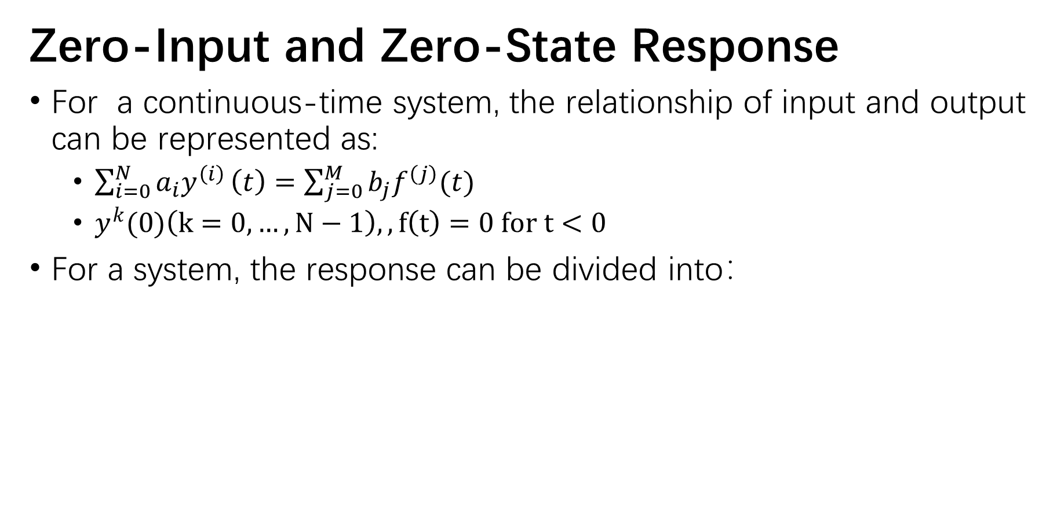
Zero-Input and Zero-State Response
For a continuous-time system, the relationship of input and output can be represented as:
$\sum_{i=0}^{N}{a_{i}y^{\left(i\right)}}\left(t\right)=\sum_{j=0}^{M}{b_{j}f^{\left(j\right)}(t)}$
$y^{k}(0)\left(k=0, …, N−1\right),,f\left(t\right)=0 for t<0$
For a system, the response can be divided into：

Slide 16
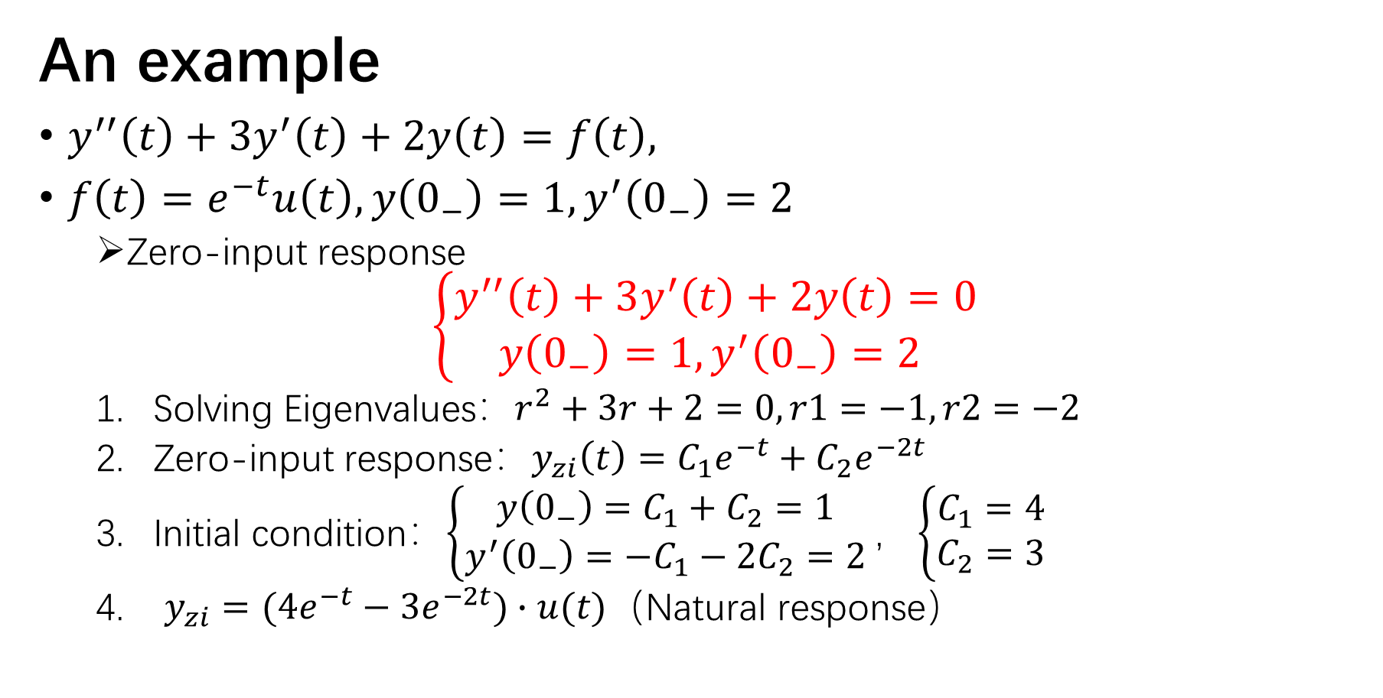
An example
$y^{′′}\left(t\right)+3y^{′}\left(t\right)+2y\left(t\right)=f\left(t\right),$
$f\left(t\right)=e^{−t}u\left(t\right), y\left(0_{−}\right)=1,y^{′}\left(0_{−}\right)=2$
Zero-input response
$$\left\{\begin{aligned}y^{′′}\left(t\right)+3y^{′}\left(t\right)+2y\left(t\right)=0 \\ y\left(0_{−}\right)=1,y^{′}\left(0_{−}\right)=2 \end{aligned}\right.$$
Solving Eigenvalues$：r^{2}+3r+2=0,r1=−1,r2=−2$
Zero-input response：$y_{zi}\left(t\right)=C_{1}e^{−t}+C_{2}e^{−2t}$
Initial condition：$\left\{\begin{matrix}y\left(0_{−}\right)=C_{1}+C_{2}=1 \\ y^{′}\left(0_{−}\right)=−C_{1}−2C_{2}=2\end{matrix}\right.，\left\{\begin{aligned}C_{1}=4 \\ C_{2}=3\end{aligned}\right.$
$y_{zi}=(4e^{−t}−3e^{−2t})∙u(t)$（Natural response）

Slide 17
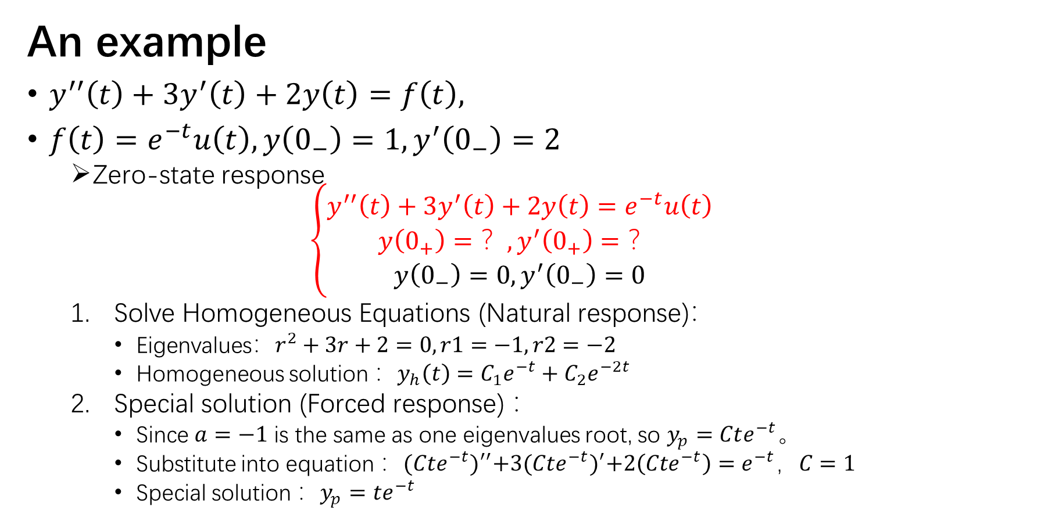
An example
$y^{′′}\left(t\right)+3y^{′}\left(t\right)+2y\left(t\right)=f\left(t\right),$
$f\left(t\right)=e^{−t}u\left(t\right), y\left(0_{−}\right)=1,y^{′}\left(0_{−}\right)=2$
Zero-state response
$$\left\{\begin{aligned}y^{′′}\left(t\right)+3y^{′}\left(t\right)+2y\left(t\right)=e^{−t}u\left(t\right) \\ y\left(0_{+}\right)=？,y^{′}\left(0_{+}\right)=？ \\ y\left(0_{−}\right)=0,y^{′}\left(0_{−}\right)=0\end{aligned}\right.$$
Solve Homogeneous Equations (Natural response)：
$\text{Eigenvalues}：r^{2}+3r+2=0,r1=−1,r2=−2$
Homogeneous solution ：$y_{h}\left(t\right)=C_{1}e^{−t}+C_{2}e^{−2t}$
Special solution (Forced response) ：
Since $a=−1$ is the same as one eigenvalues root, so $y_{p}=Cte^{−t}$。
Substitute into equation ：${(Cte^{−t})}^{′′}+3{(Cte^{−t})}^{′}+2\left(Cte^{−t}\right)=e^{−t}，C=1$
Special solution ：$y_{p}=te^{−t}$

Slide 18
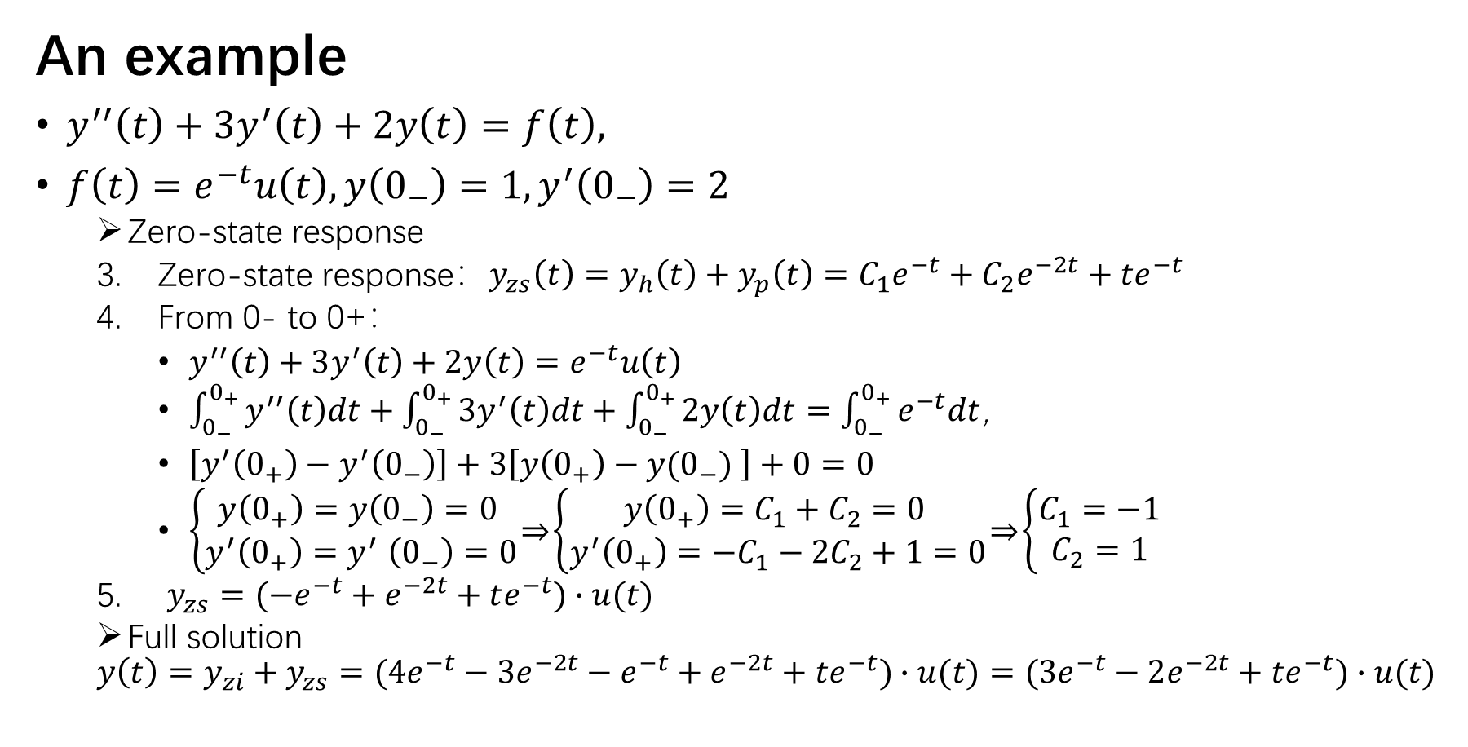
An example
$y^{′′}\left(t\right)+3y^{′}\left(t\right)+2y\left(t\right)=f\left(t\right),$
$f\left(t\right)=e^{−t}u\left(t\right), y\left(0_{−}\right)=1,y^{′}\left(0_{−}\right)=2$
Zero-state response
Zero-state response：$y_{zs}\left(t\right)=y_{h}\left(t\right)+y_{p}\left(t\right)=C_{1}e^{−t}+C_{2}e^{−2t}+te^{−t}$
From 0- to 0+：
$y^{′′}\left(t\right)+3y^{′}\left(t\right)+2y\left(t\right)=e^{−t}u\left(t\right)$
$\int_{0_{−}}^{0_{+}}{y^{′′}\left(t\right)dt}+\int_{0_{−}}^{0_{+}}{3y^{′}\left(t\right)dt}+\int_{0_{−}}^{0_{+}}{2y\left(t\right)dt}=\int_{0_{−}}^{0_{+}}{e^{−t}dt}$，
$\left[y^{′}\left(0_{+}\right)−y^{′}\left(0_{−}\right)\right]+3\left[y\left(0_{+}\right)−y(0_{−}) \right]+0=0$
$\left\{\begin{aligned}y\left(0_{+}\right)=y\left(0_{−}\right)=0 \\ y^{′}\left(0_{+}\right){=y}^{′}\left(0_{−}\right)=0\end{aligned}\right.\underset{⇒}{ }\left\{\begin{aligned}y\left(0_{+}\right)=C_{1}+C_{2}=0 \\ y^{′}\left(0_{+}\right)=−C_{1}−2C_{2}+1=0\end{aligned}\right.\underset{⇒}{ }\left\{\begin{aligned}C_{1}=−1 \\ C_{2}=1\end{aligned}\right.$
$y_{zs}=(−e^{−t}+e^{−2t}+te^{−t})∙u(t)$
Full solution
$$y\left(t\right)=y_{zi}+y_{zs}=(4e^{−t}−3e^{−2t}−e^{−t}+e^{−2t}+te^{−t})∙u(t)=(3e^{−t}−2e^{−2t}+te^{−t})∙u(t)$$

Slide 19
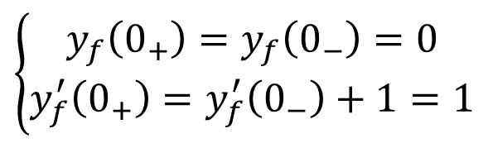
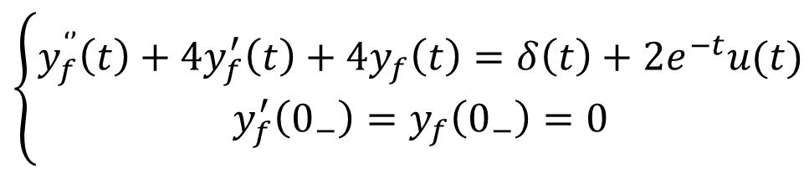

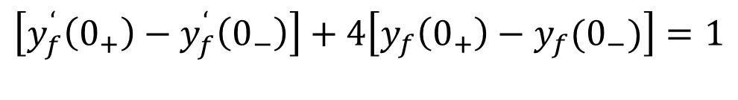

An example for different 0+ and 0-
$$\left\{\begin{aligned}y_{f}^{‘’}\left(t\right)+4y_{f}^{′}\left(t\right)+4y_{f}\left(t\right)=δ\left(t\right)+2e^{−t}u(t) \\ y_{f}^{′}\left(0_{−}\right)=y_{f}\left(0_{−}\right)=0\end{aligned}\right.$$
$$y_{f}\left(t\right)=y_{t}+y_{p}=C_{1}e^{−2t}+C_{2}te^{−2t}+2e^{−t},t≥0$$
$$\int_{0_{−}}^{0_{+}}{y_{f}^{‘’}\left(t\right)dt}+4\int_{0_{−}}^{0_{+}}{y_{f}^{‘}\left(t\right)dt}+4\int_{0_{−}}^{0_{+}}{y_{f}\left(t\right)dt}=\int_{0_{−}}^{0_{+}}{δ(t)dt}+2\int_{0_{−}}^{0_{+}}{e^{−t}u(t)dt}$$
$$\left[y_{f}^{‘}\left(0_{+}\right)−y_{f}^{‘}\left(0_{−}\right)\right]+4\left[y_{f}\left(0_{+}\right)−y_{f}(0_{−})\right]=1$$
$$y_{f}\left(0_{+}\right)−y_{f}\left(0_{−}\right)=0$$
$$y_{f}^{’}\left(0_{+}\right)=y_{f}^{’}\left(0_{−}\right)+1=1$$
$$\left\{\begin{aligned}y_{f}\left(0_{+}\right)=y_{f}\left(0_{−}\right)=0 \\ y_{f}^{′}\left(0_{+}\right)=y_{f}^{′}\left(0_{−}\right)+1=1\end{aligned}\right.$$
$$⟹$$

Slide 20
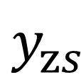


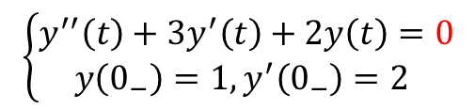
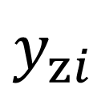

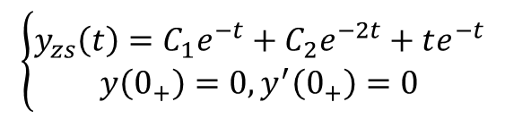



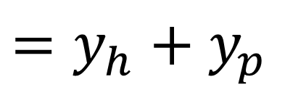
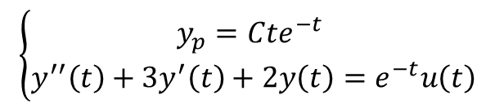
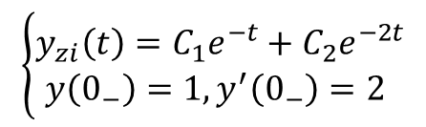
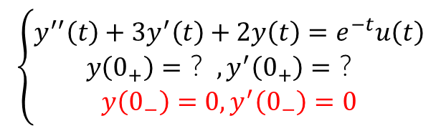
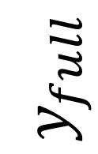

$$y_{zi}$$
$$\left\{\begin{aligned}y^{′′}\left(t\right)+3y^{′}\left(t\right)+2y\left(t\right)=0 \\ y\left(0_{−}\right)=1,y^{′}\left(0_{−}\right)=2 \end{aligned}\right.$$
$$\left\{\begin{aligned}y_{zi}\left(t\right)=C_{1}e^{−t}+C_{2}e^{−2t} \\ y\left(0_{−}\right)=1,y^{′}\left(0_{−}\right)=2 \end{aligned}\right.$$
$$y_{zi}=(4e^{−t}−3e^{−2t})∙u(t)$$
$$y_{full}$$
$$y_{zs}$$
$$y_{h}$$
$$=y_{h}+y_{p}$$
$$y_{h}=C_{1}e^{−t}+C_{2}e^{−2t}$$
$$y^{′′}\left(t\right)+3y^{′}\left(t\right)+2y\left(t\right)=0$$
$$\left\{\begin{aligned}y^{′′}\left(t\right)+3y^{′}\left(t\right)+2y\left(t\right)=e^{−t}u\left(t\right) \\ y\left(0_{+}\right)=？,y^{′}\left(0_{+}\right)=？ \\ y\left(0_{−}\right)=0,y^{′}\left(0_{−}\right)=0\end{aligned}\right.$$
$$y_{p}$$
$$y_{p}=te^{−t}$$
$$\left\{\begin{aligned}y_{p}=Cte^{−t} \\ y^{′′}\left(t\right)+3y^{′}\left(t\right)+2y\left(t\right)=e^{−t}u\left(t\right)\end{aligned}\right.$$
$$\left\{\begin{aligned}y_{zs}\left(t\right)=C_{1}e^{−t}+C_{2}e^{−2t}+te^{−t} \\ y\left(0_{+}\right)=0,y^{′}\left(0_{+}\right)=0\end{aligned}\right.$$
$$y_{zs}=(−e^{−t}+e^{−2t}+te^{−t})∙u(t)$$

Slide 21
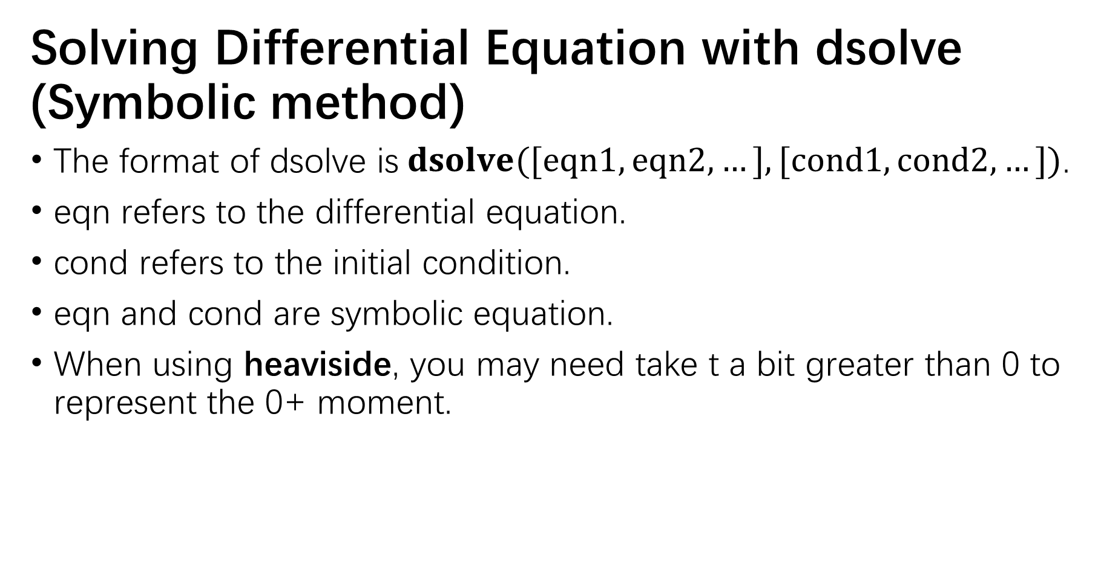
e.g.
Solving Differential Equation with dsolve (Symbolic method)
The format of dsolve is$dsolve([eqn1,eqn2,…],[cond1,cond2,…])$.
eqn refers to the differential equation.
cond refers to the initial condition.
eqn and cond are symbolic equation.
When using heaviside, you may need take t a bit greater than 0 to represent the 0+ moment.

Slide 22
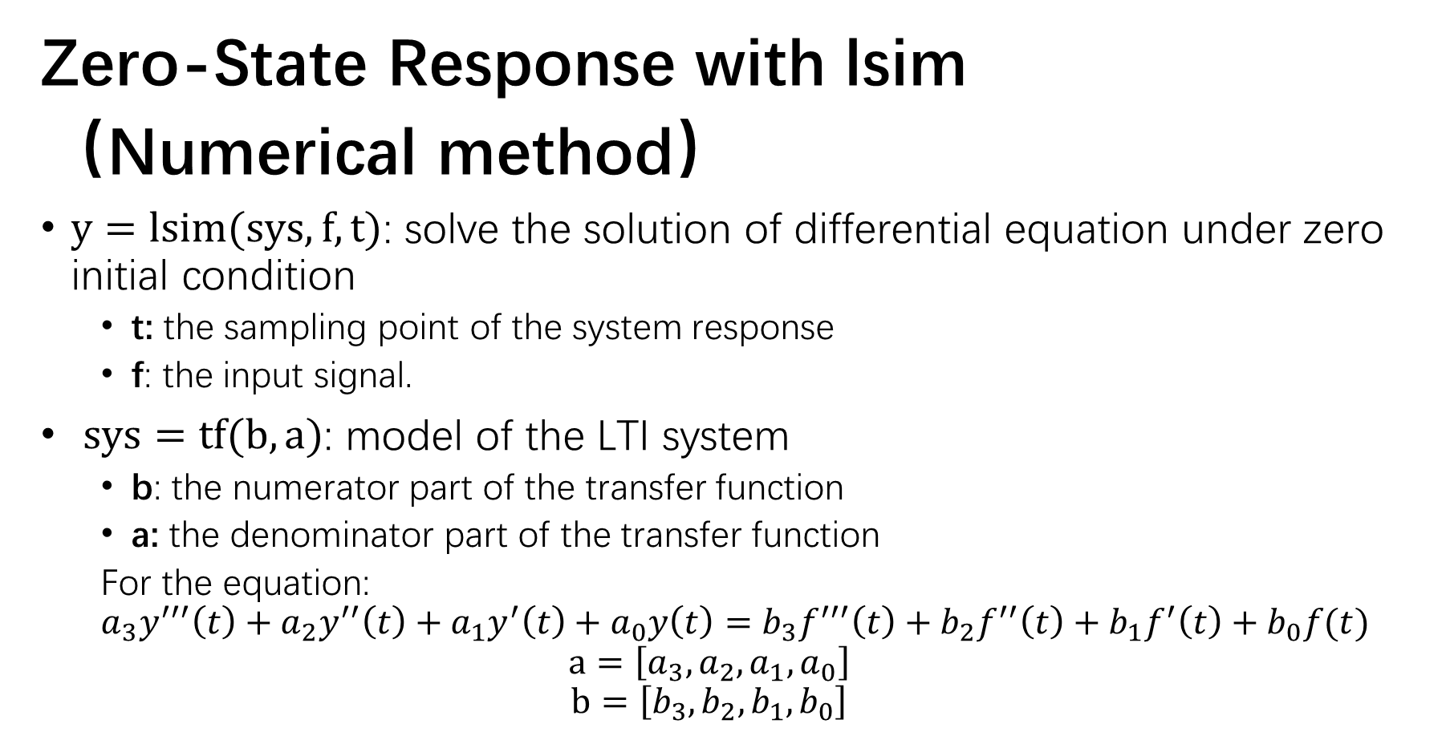
e.g.
Zero-State Response with lsim
（Numerical method）
$y=lsim(sys, f, t)$: solve the solution of differential equation under zero initial condition
t: the sampling point of the system response
f: the input signal.
$sys=tf(b,a)$: model of the LTI system
b: the numerator part of the transfer function
a: the denominator part of the transfer function
For the equation:
$$a_{3}y^{′′′}\left(t\right)+a_{2}y^{′′}\left(t\right)+a_{1}y^{′}\left(t\right)+a_{0}y\left(t\right)=b_{3}f^{′′′}\left(t\right)+b_{2}f^{′′}\left(t\right)+b_{1}f^{′}\left(t\right)+b_{0}f(t)$$
$$a=\left[a_{3},a_{2},a_{1},a_{0}\right]$$
$$b=\left[b_{3},b_{2},b_{1},b_{0}\right]$$

Slide 23
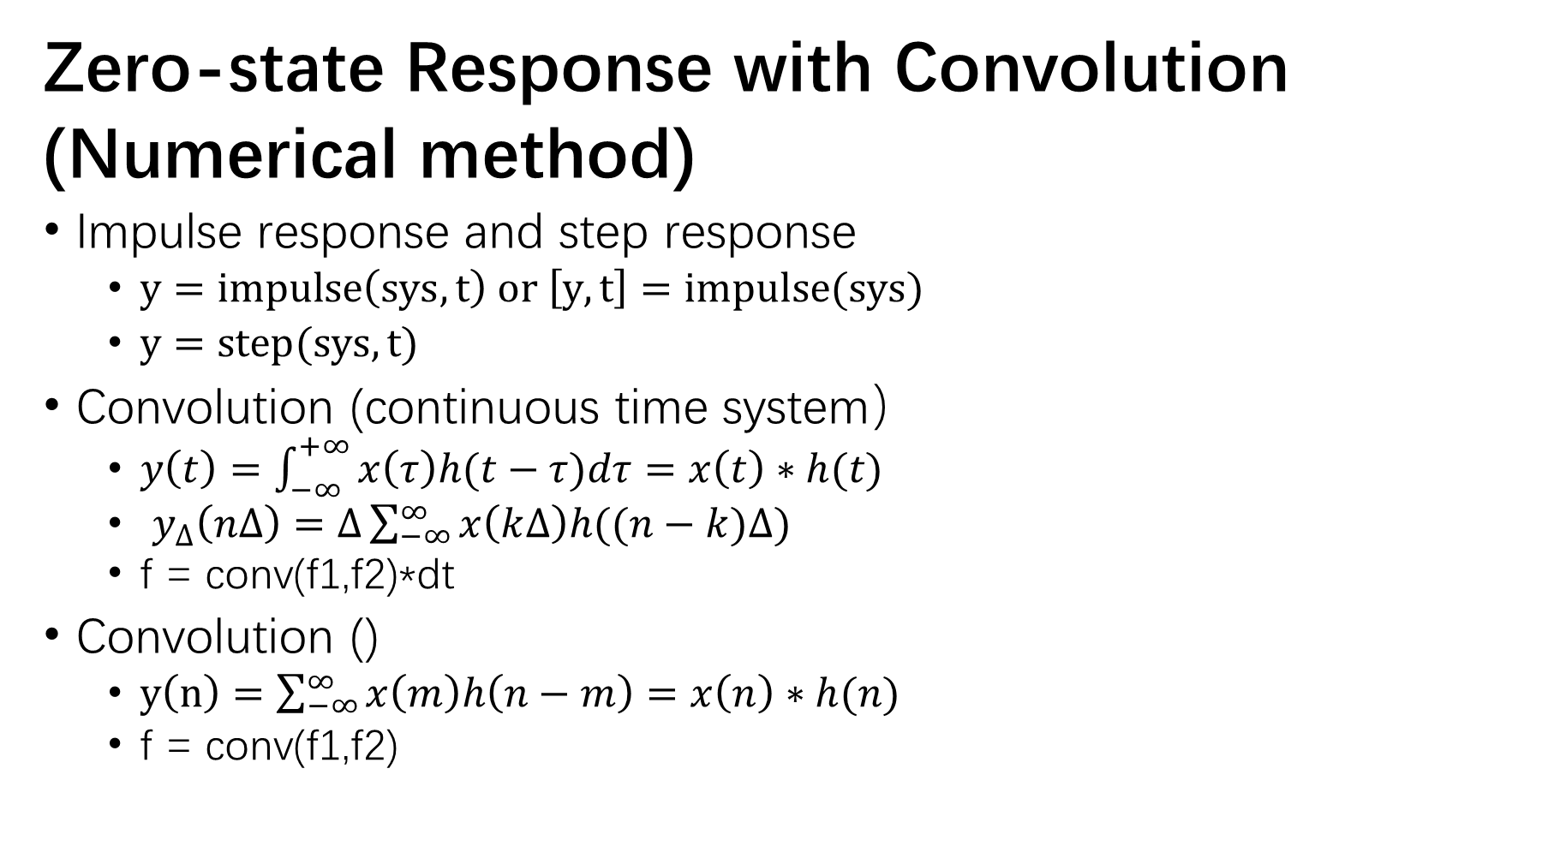
Zero-state Response with Convolution
(Numerical method)
Impulse response and step response
$y=impulse\left(sys,t\right) or \left[y,t\right]=impulse(sys)$
$y=step(sys,t)$
Convolution (continuous time system）
$y\left(t\right)=\int_{−∞}^{+∞}{x\left(τ\right)h(t−τ)dτ}=x\left(t\right)∗h(t)$
$y_{∆}\left(n∆\right)=∆\sum_{−∞}^{∞}{x\left(k∆\right)h((n−k)∆)}$
f = conv(f1,f2)*dt
Convolution ()
$y\left(n\right)=\sum_{−∞}^{∞}{x\left(m\right)h\left(n−m\right)=x\left(n\right)∗h(n)}$
f = conv(f1,f2)

Slide 24
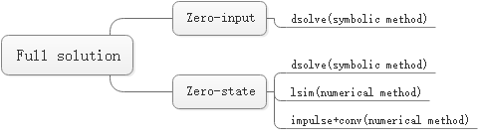
Methods Summary

